Slide 1
Pre-trained Model in NLP —— tranfer learning in NLP
Zhaopo Liao
Computer Science Department
Tsinghua University

Slide 2
Paper List
Matthew Peters, Mark Neumann, and etc. 2018. Deep contextualized word representations. In NAACL.
Jeremy Howard and Sebastian Ruder. 2018. Universal language model fine-tuning for text classification. In ACL.
Alec Radford, Karthik Narasimhan, and etc. 2018. Improving Language Understanding by Generative Pre-Training.
Alan Akbik, Duncan Blythe and Roland Vollgraf. 2018. Contextual String Embeddings for Sequence Labeling. In COLING
BERT:Pre-training of Deep Bidirectional Transformers for Language Understanding

Slide 3
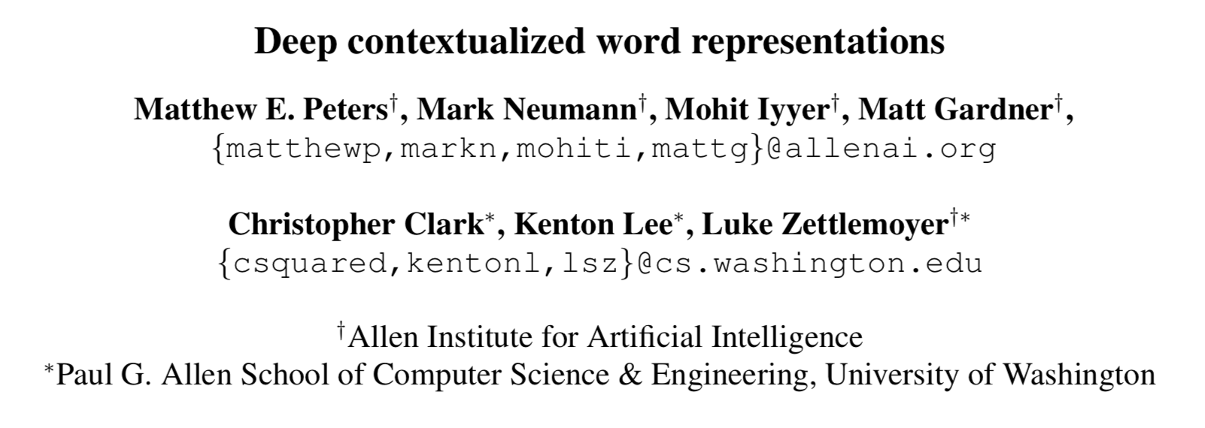

Slide 4
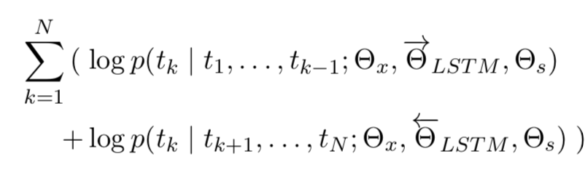
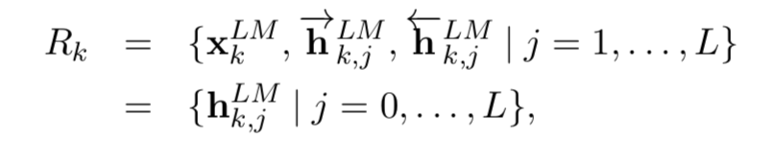
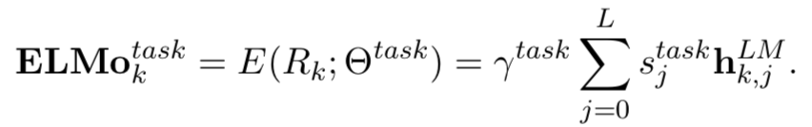
Model
Language Model
Representations
embeddings

Slide 5
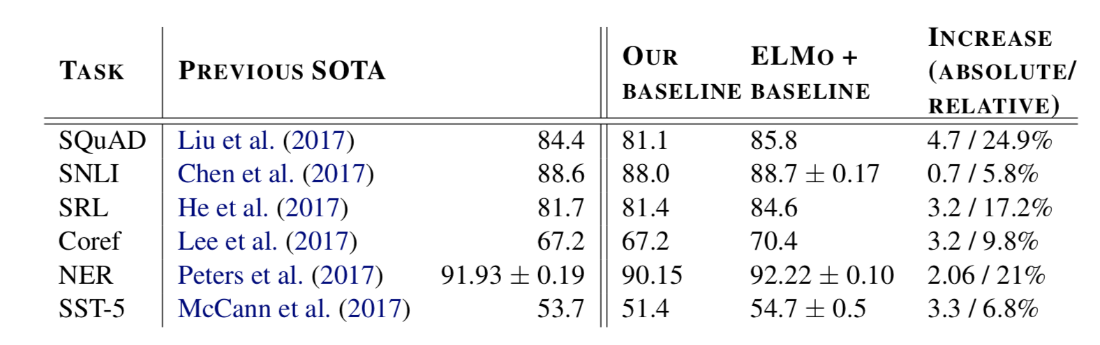
Experiments

Slide 6
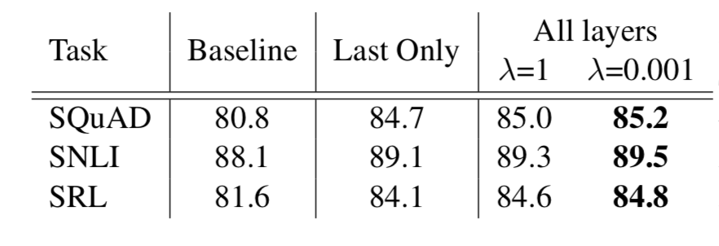
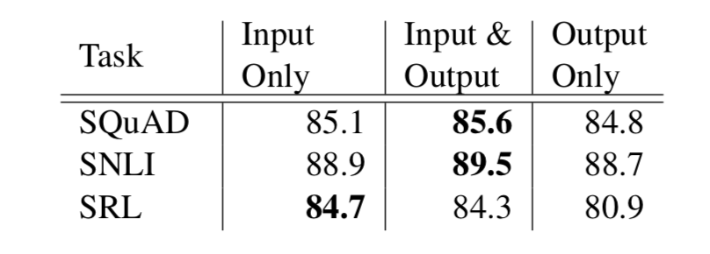
Analysis

Slide 7
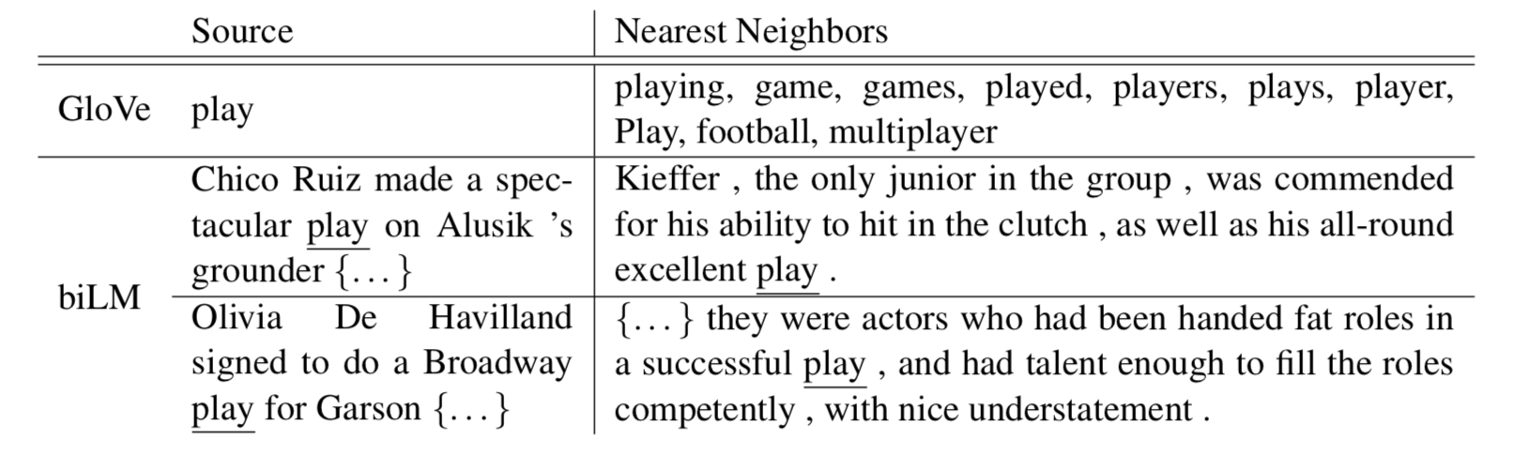
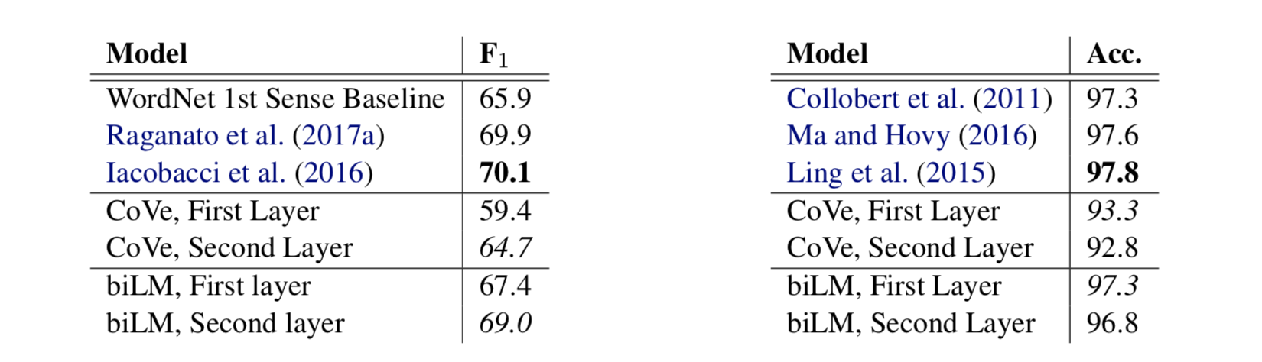
Analysis

Slide 8
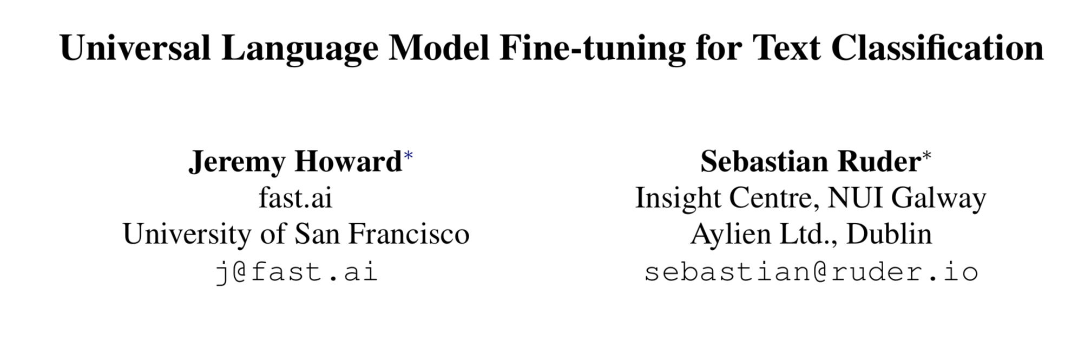

Slide 9
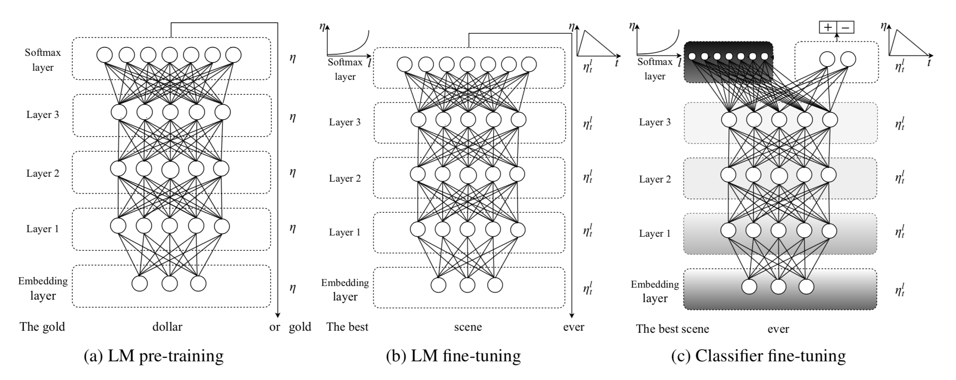
Model

Slide 10
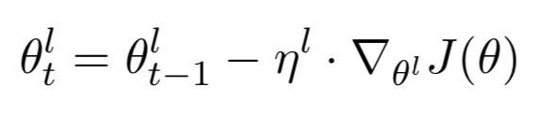
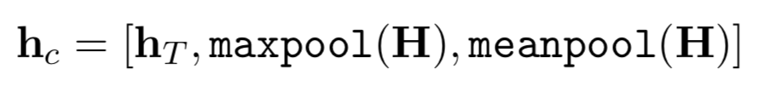
Model
Discriminative fine-tune
Slanted triangular learning rates
Concat pooling
Gradual unfreezing

Slide 11
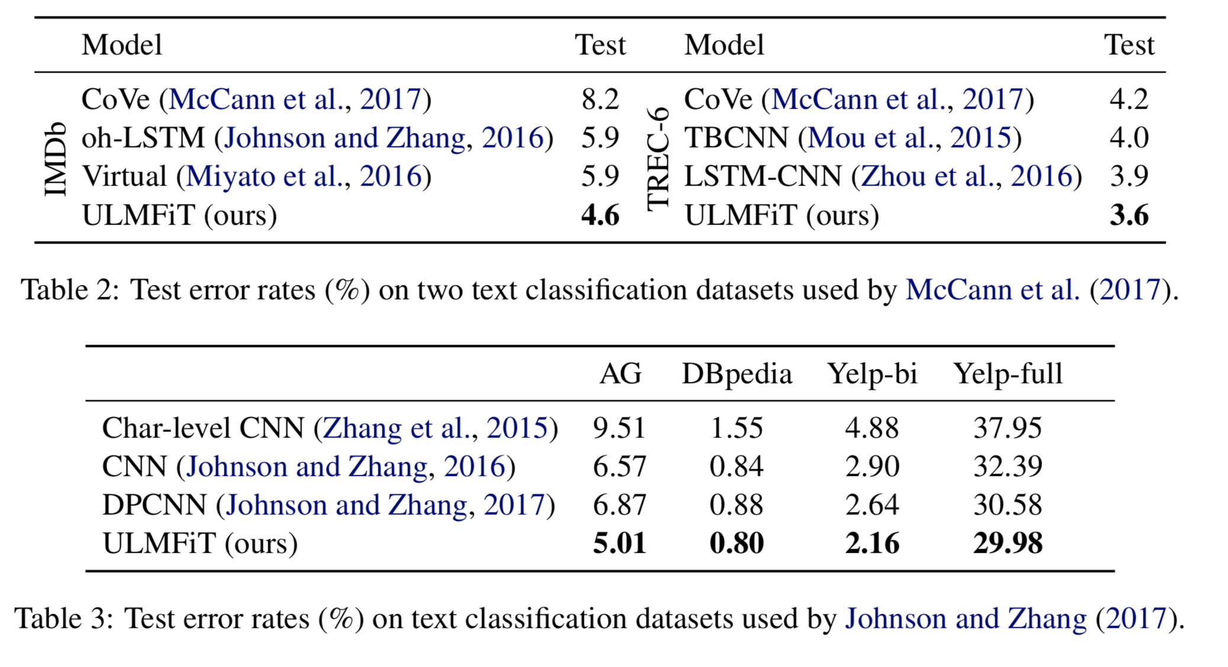
Experiments

Slide 12
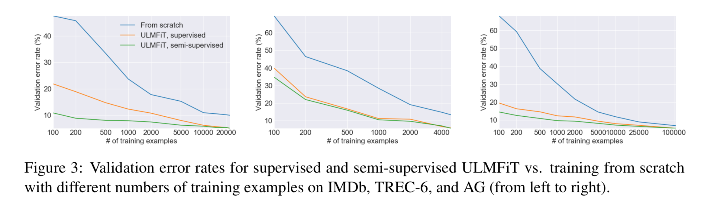
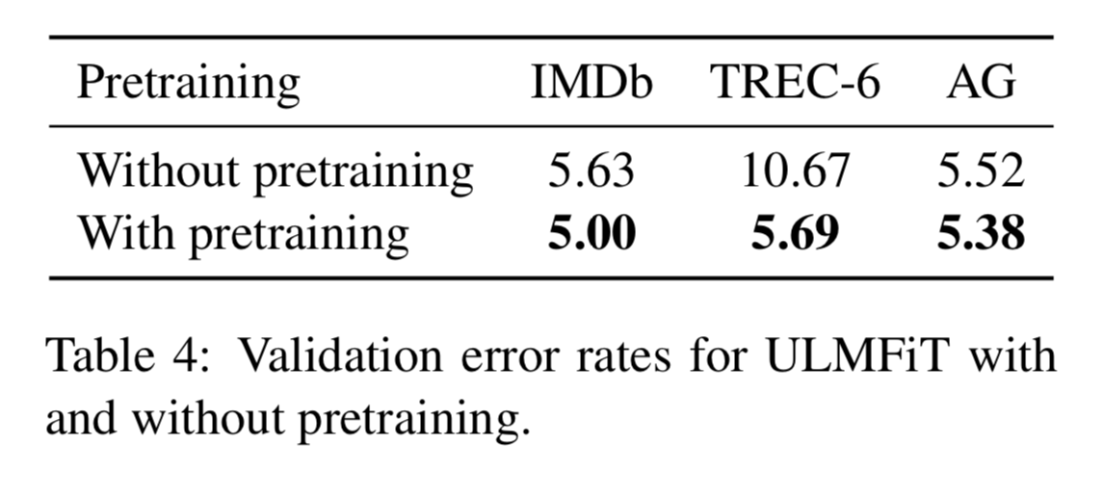
Analysis

Slide 13
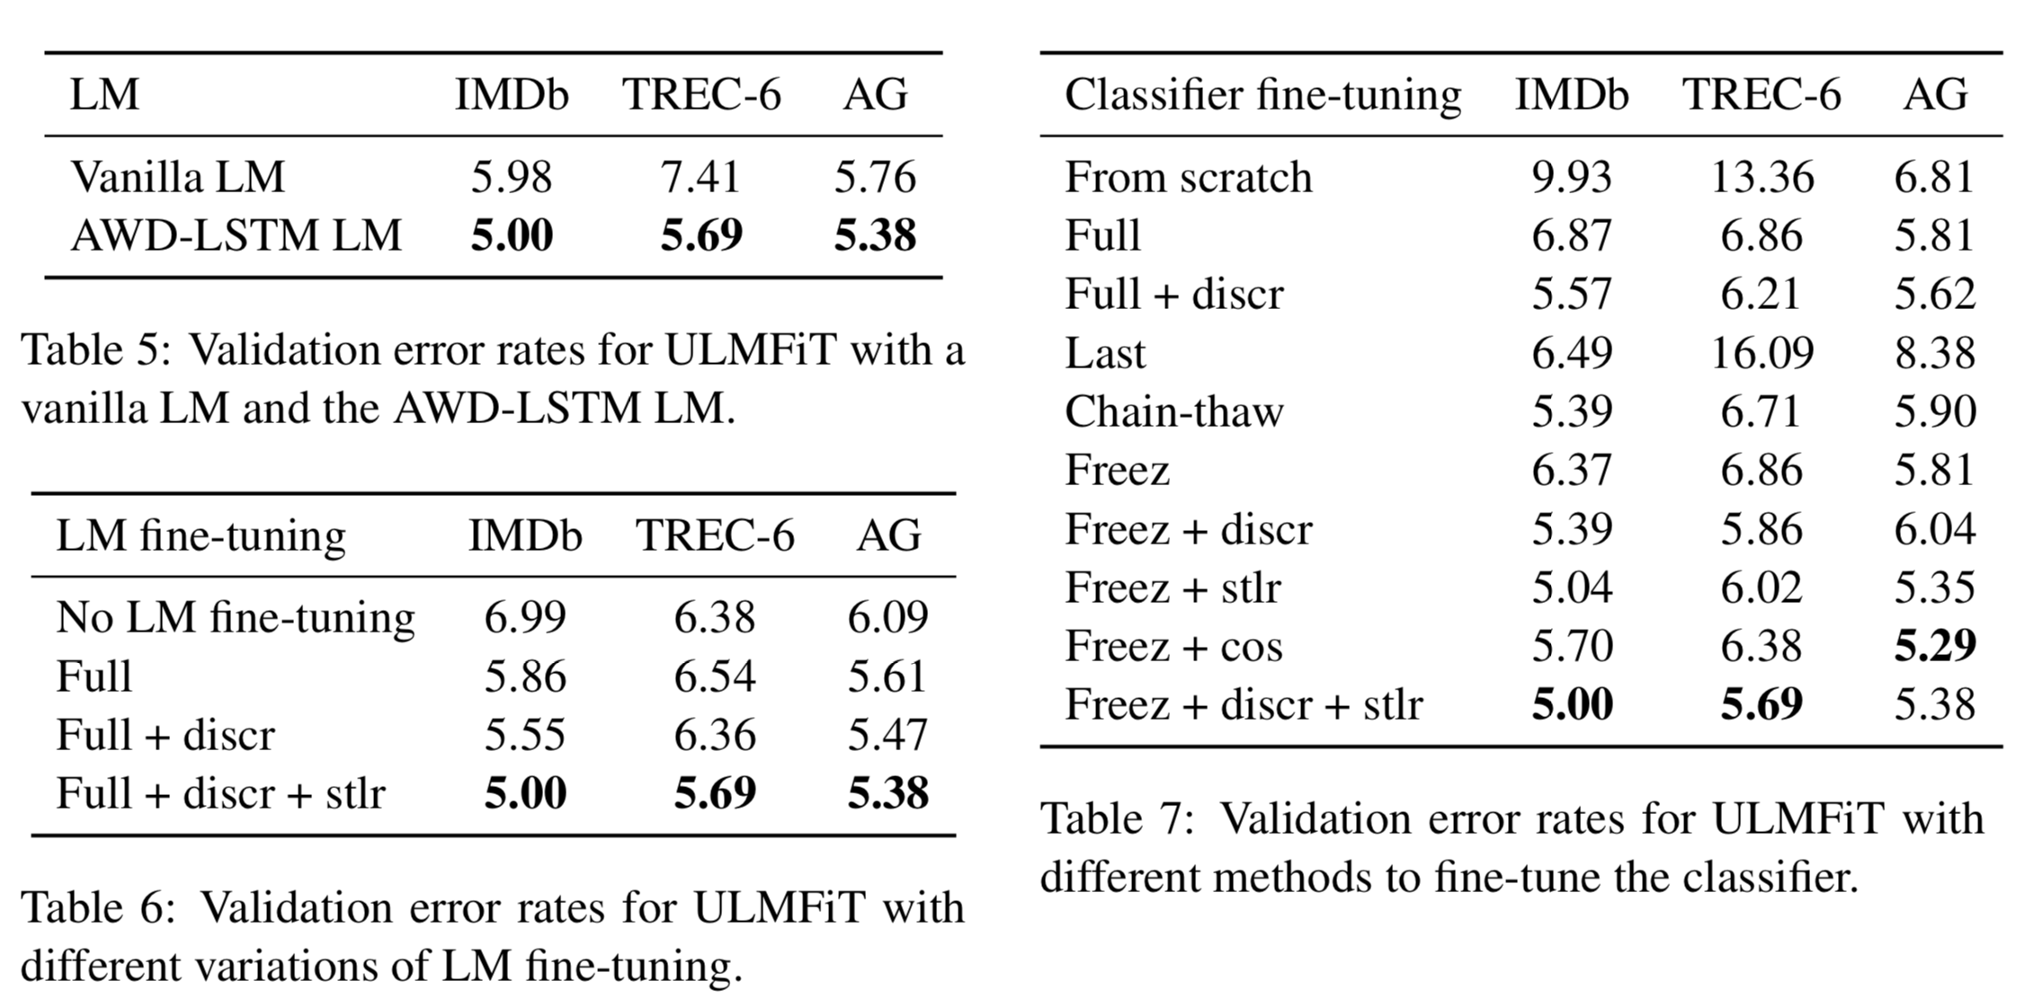
Analysis

Slide 14
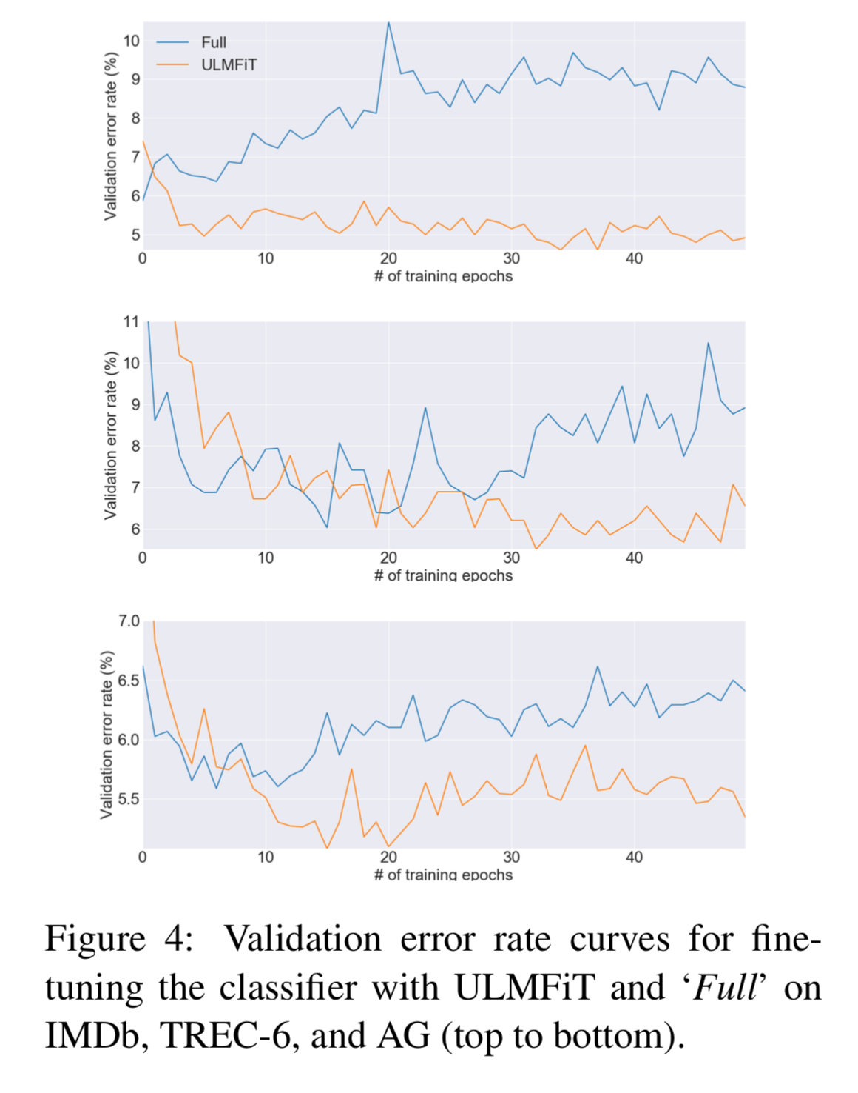
Analysis

Slide 15
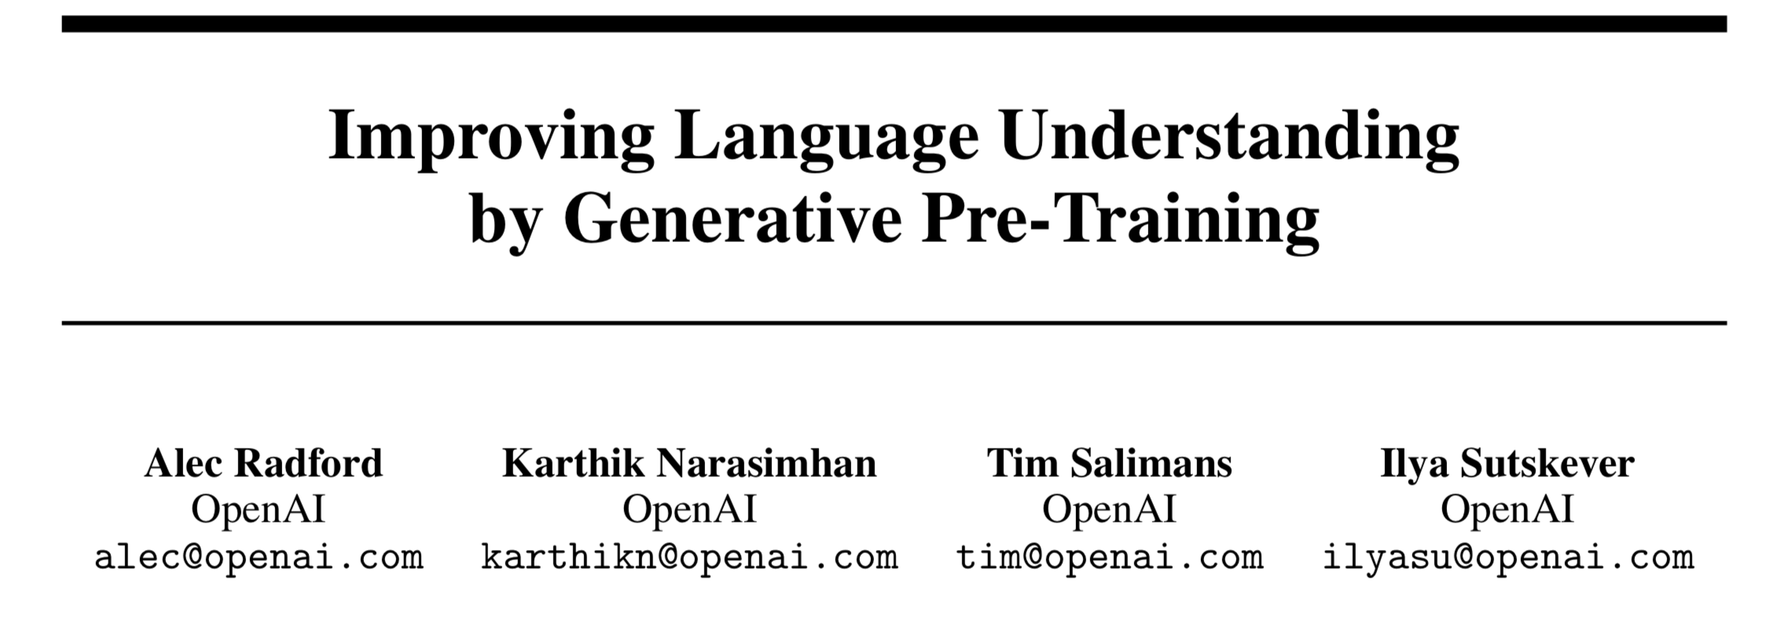

Slide 16
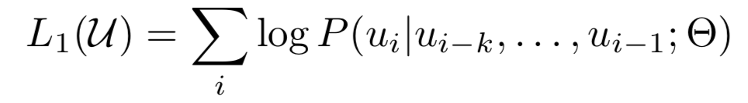
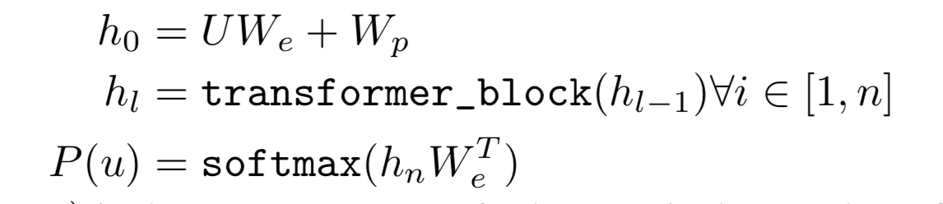
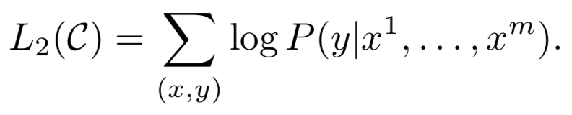
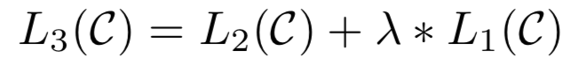
Model
Unsupervised pre-training
Supervised fine-tuning

Slide 17
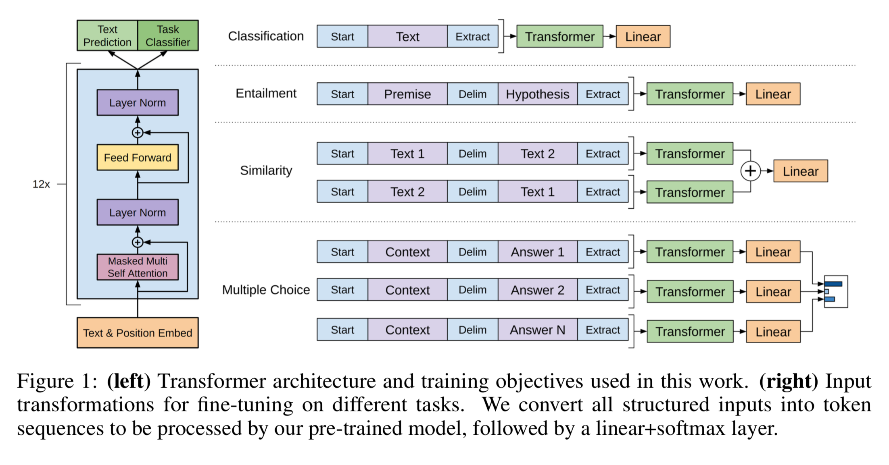
Model

Slide 18
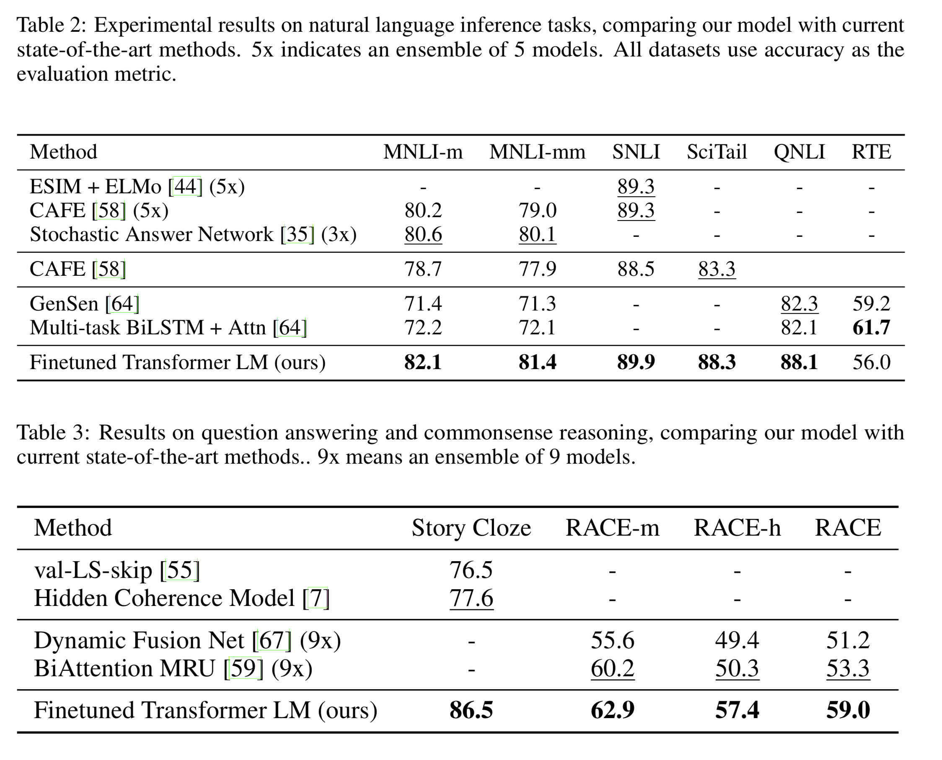
Experiments

Slide 19
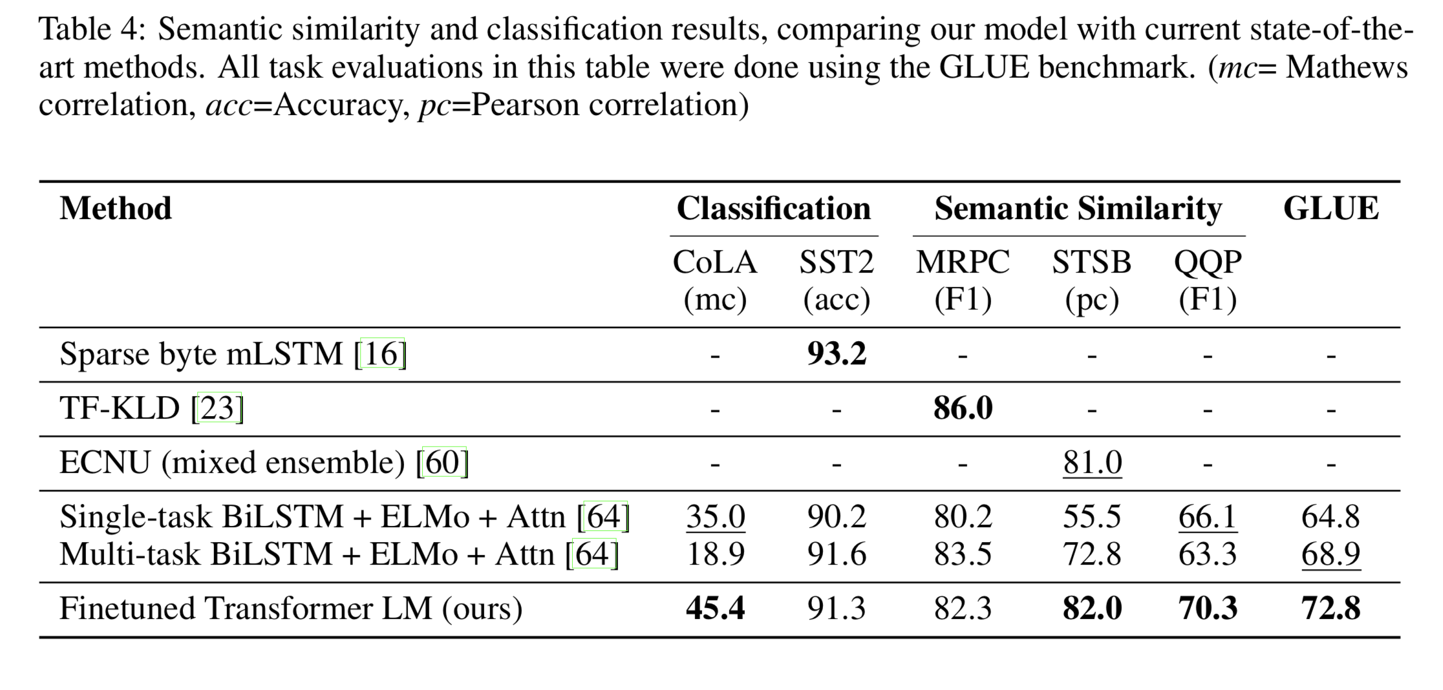
Experiments

Slide 20
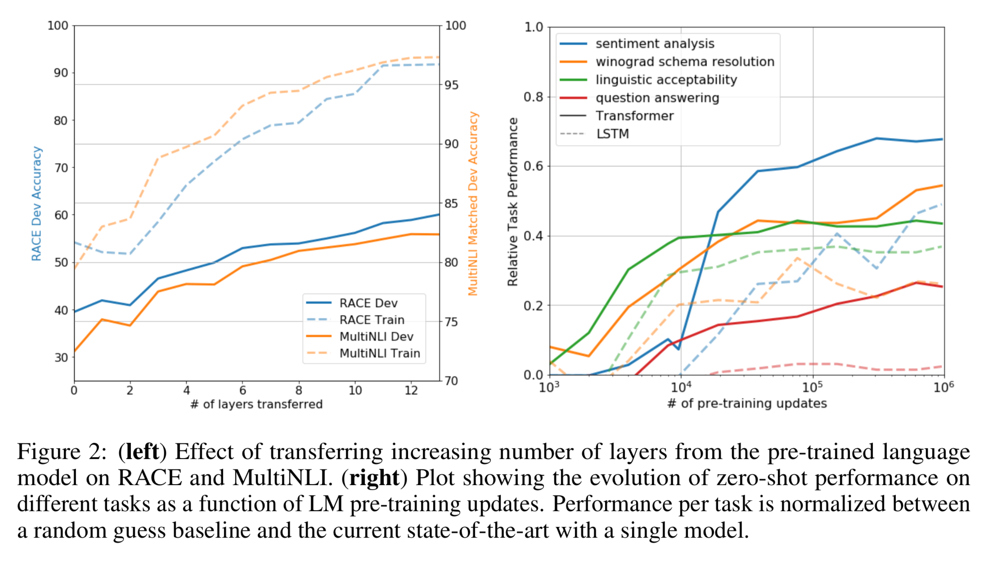
Analysis

Slide 21
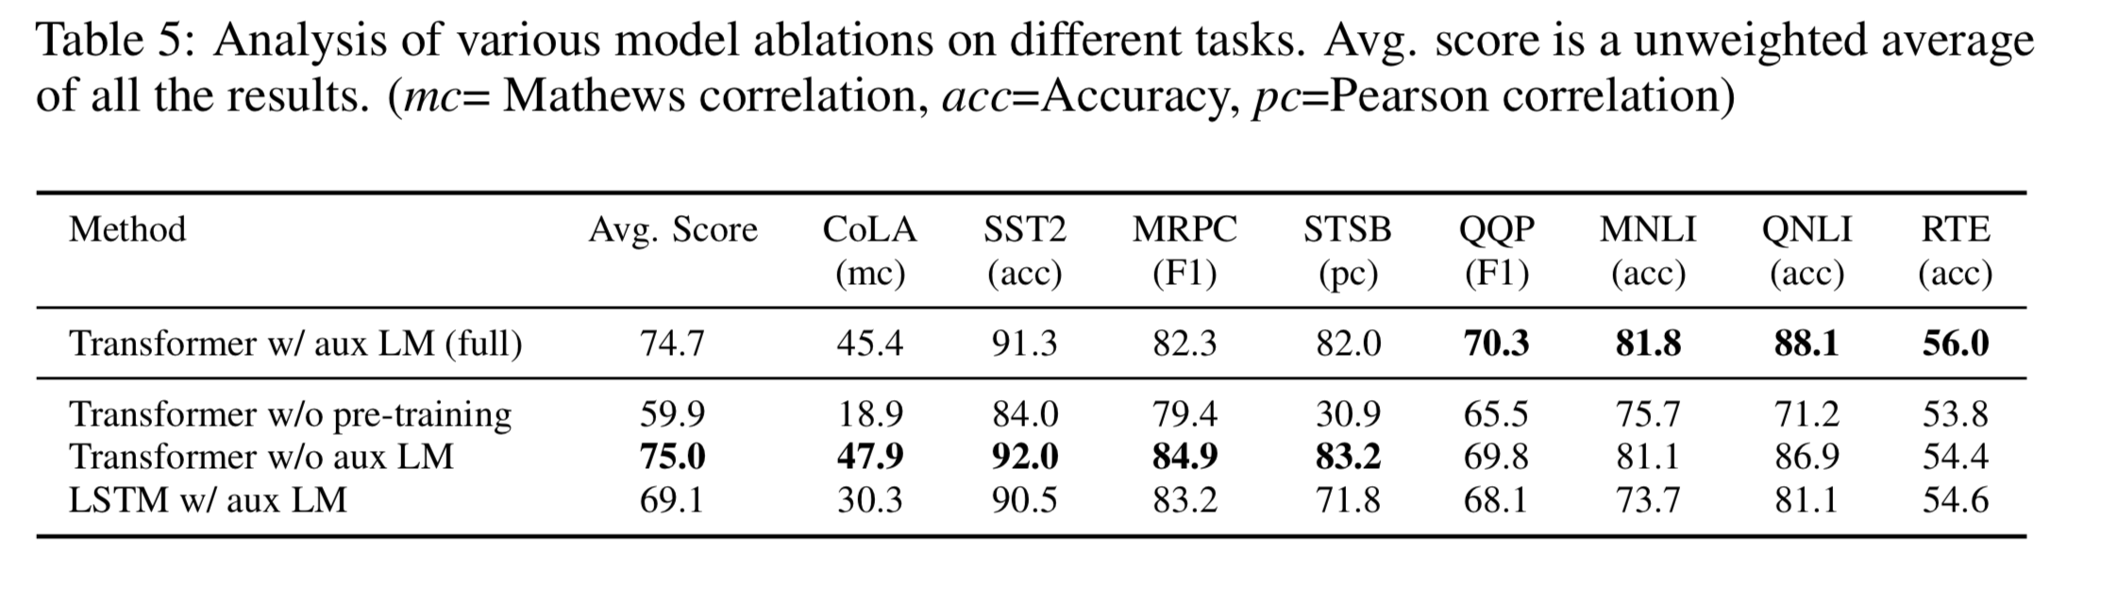
Analysis

Slide 22
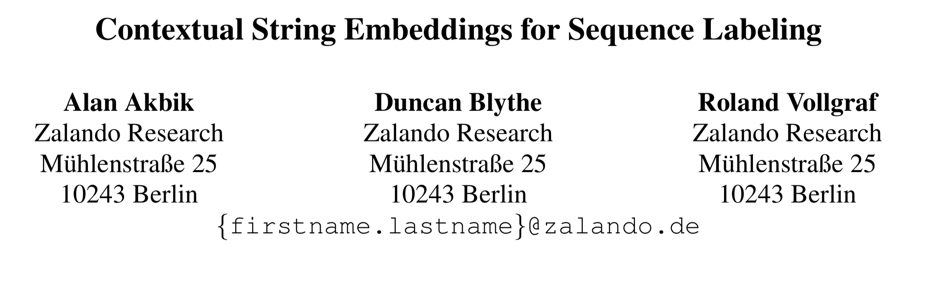

Slide 23
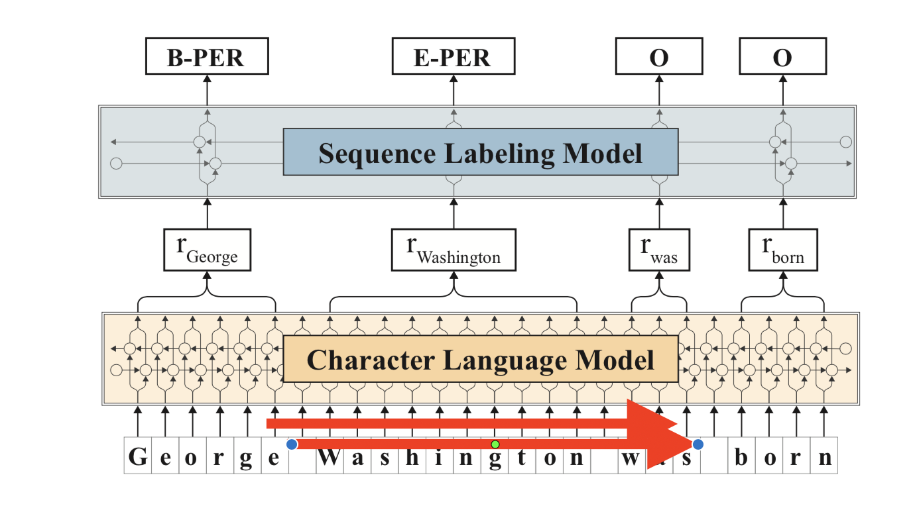
Model

Slide 24
